Slide 1
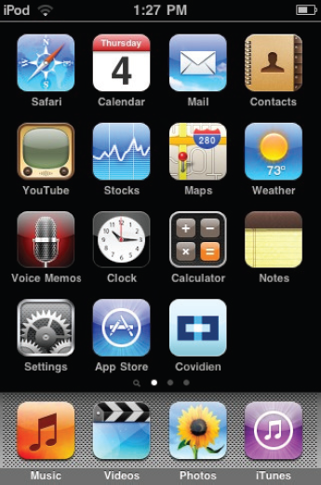
Covidien: iPod Touch Application
Cost Analysis Tool Overview

Slide 2
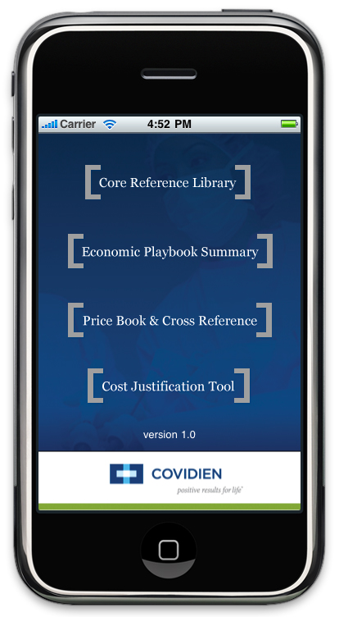
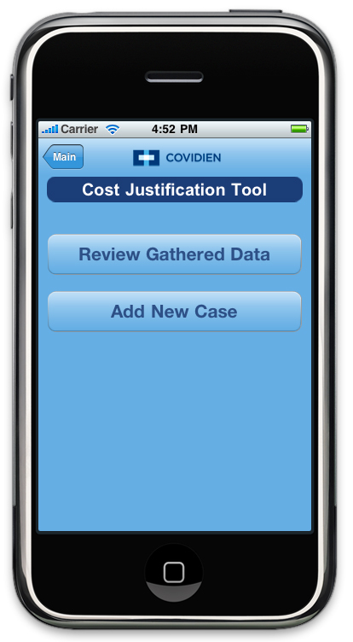
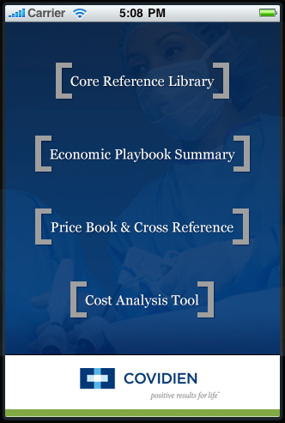
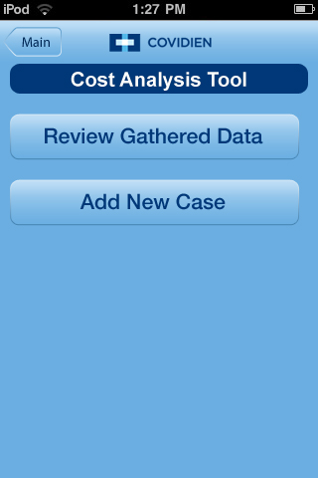
App Overview – Cost Analysis Tool
<number> |
COVIDIEN, COVIDIEN with logo and positive results for life are U.S. and/or internationally registered trademarks of Covidien AG. Other brands are trademarks of a Covidien company. © 2010 Covidien. All rights reserved. R0012720

Slide 3
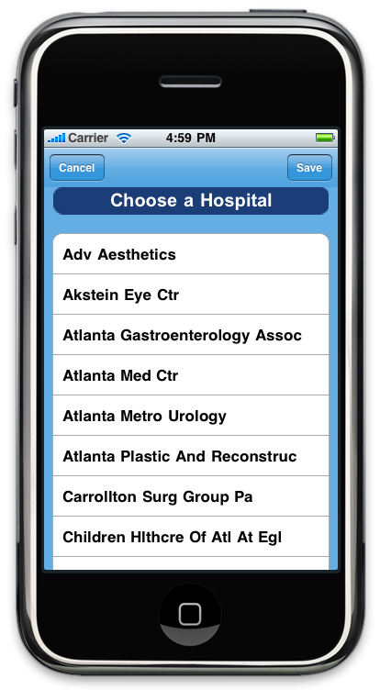
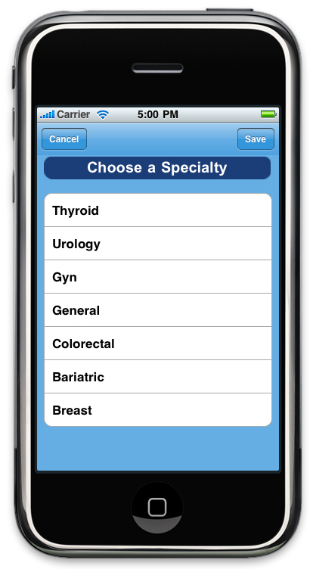
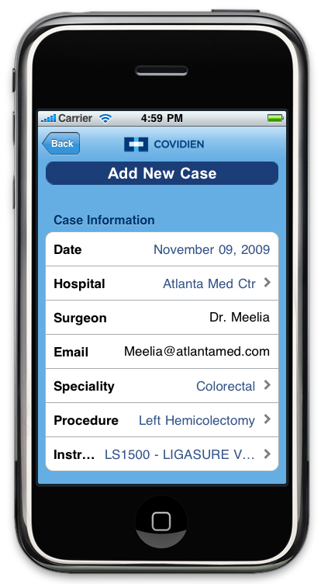
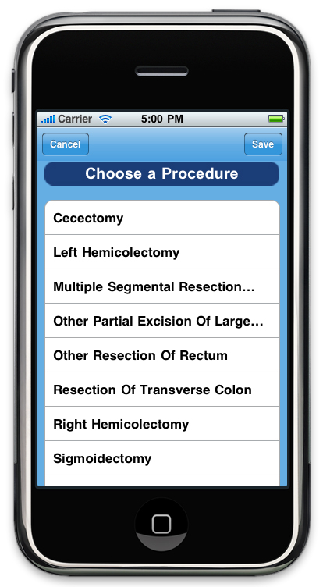
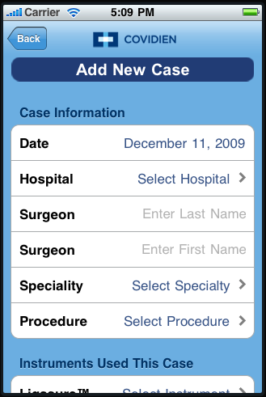
Data Entry
<number> |
COVIDIEN, COVIDIEN with logo and positive results for life are U.S. and/or internationally registered trademarks of Covidien AG. Other brands are trademarks of a Covidien company. © 2010 Covidien. All rights reserved. R0012720

Slide 4
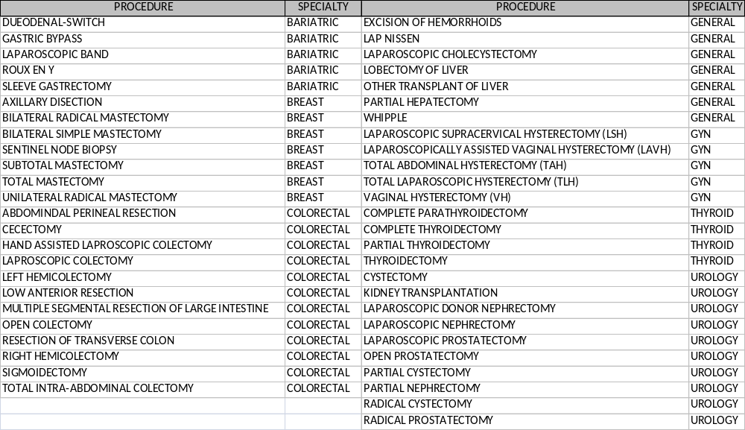
Procedure and Specialty Pick List
<number> |
COVIDIEN, COVIDIEN with logo and positive results for life are U.S. and/or internationally registered trademarks of Covidien AG. Other brands are trademarks of a Covidien company. © 2010 Covidien. All rights reserved. R0012720

Slide 5
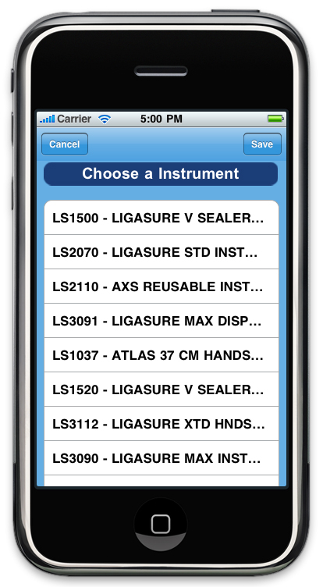
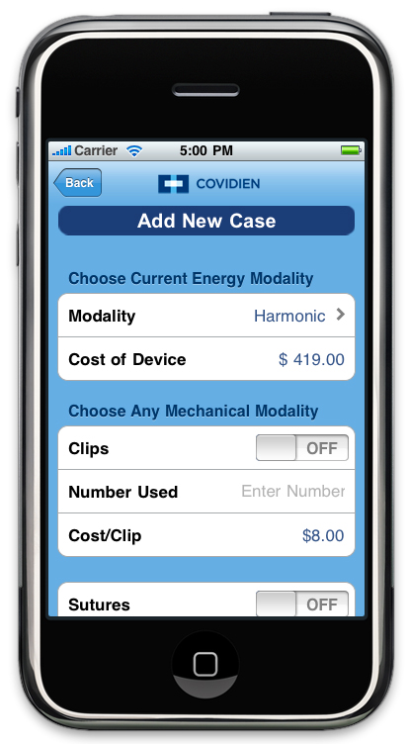
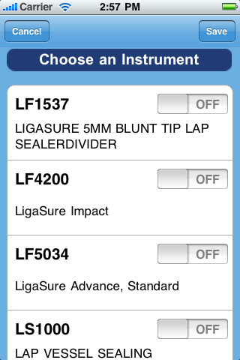
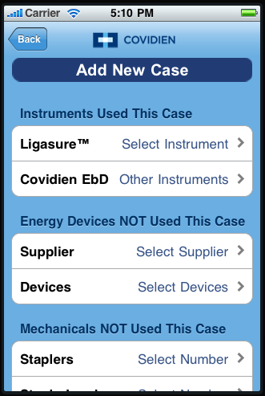
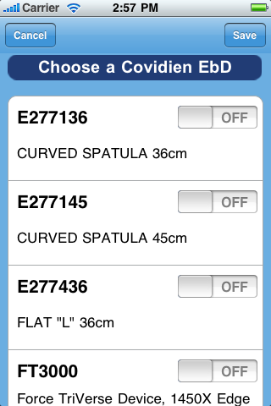
Covidien Products
Will become limited product specific list
<number> |
COVIDIEN, COVIDIEN with logo and positive results for life are U.S. and/or internationally registered trademarks of Covidien AG. Other brands are trademarks of a Covidien company. © 2010 Covidien. All rights reserved. R0012720

Slide 6
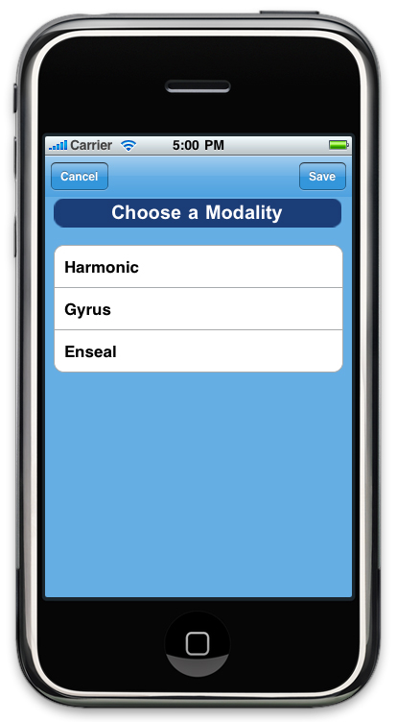
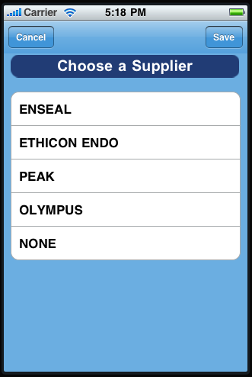
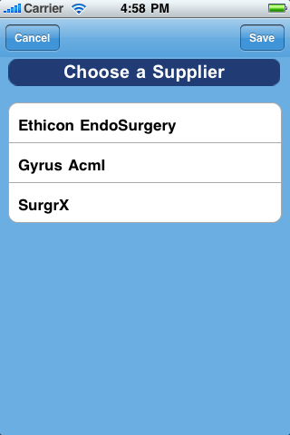
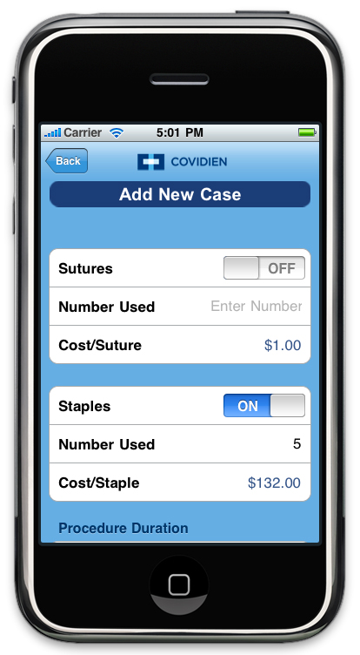
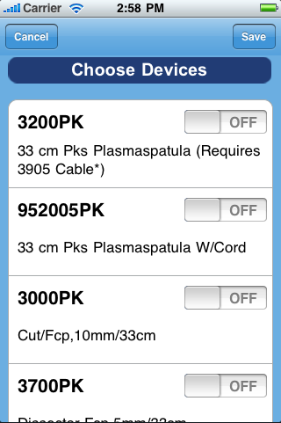
Competitive Device
Will become limited product specific list
If more than one competitive product is not used, repeat selection process and save a second time.
<number> |
COVIDIEN, COVIDIEN with logo and positive results for life are U.S. and/or internationally registered trademarks of Covidien AG. Other brands are trademarks of a Covidien company. © 2010 Covidien. All rights reserved. R0012720

Slide 7
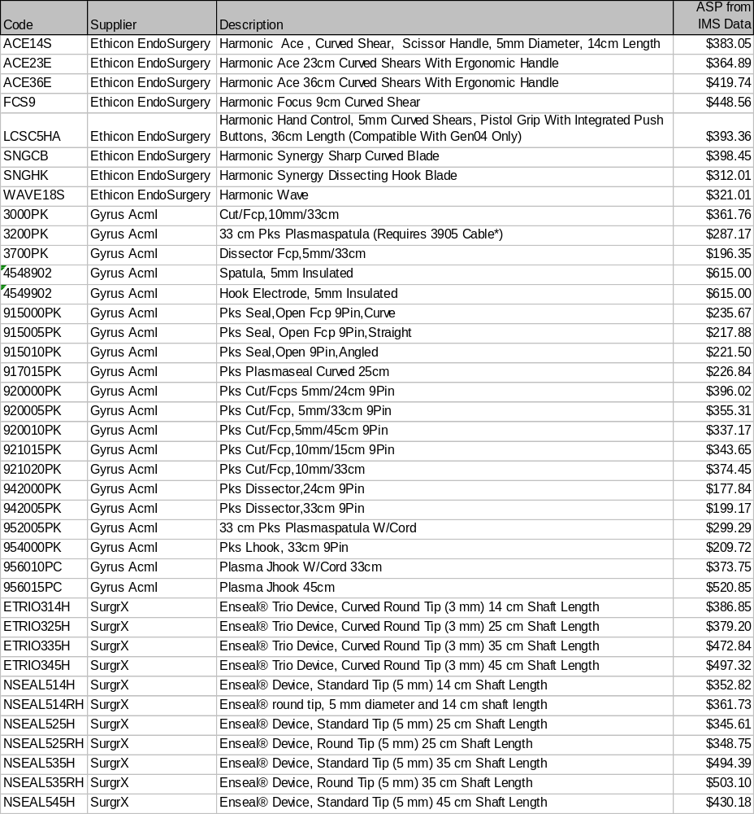
Competitive Product Pick List
<number> |
COVIDIEN, COVIDIEN with logo and positive results for life are U.S. and/or internationally registered trademarks of Covidien AG. Other brands are trademarks of a Covidien company. © 2010 Covidien. All rights reserved. R0012720

Slide 8
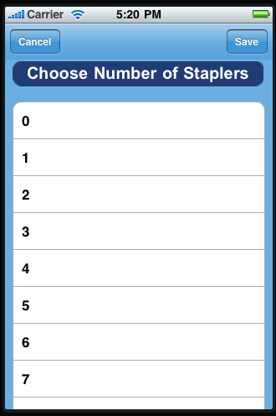
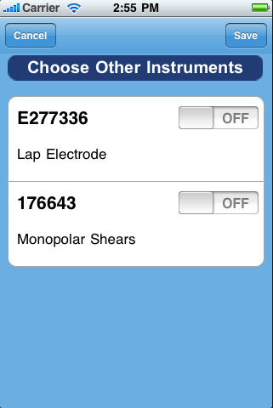
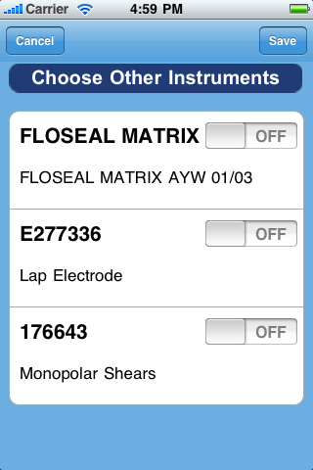
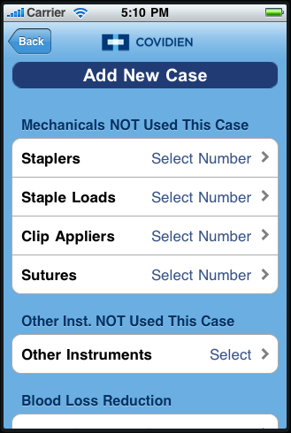
Data Entry
Mechanical
Code | Supplier | Description | ASP from IMS Data
LG113 | Covidien | Suture | $1.55
030449 | Covidien | Stapler | $110.93
030457 | Covidien | Staple Load | $224.00
176657 | Covidien | Clip Applier | $75.29
Other Instruments Not Used
Code | Supplier | Description | ASP from IMS data
176643 | Covidien | Monopolar Schears | $67.19
E277336 | Covidien | Lap Electrode | $45.09
FLOSEAL MATRIX | Baxter BioScience | FLOSEAL MATRIX AYW 01/03 | $170.50
<number> |
COVIDIEN, COVIDIEN with logo and positive results for life are U.S. and/or internationally registered trademarks of Covidien AG. Other brands are trademarks of a Covidien company. © 2010 Covidien. All rights reserved. R0012720

Slide 9
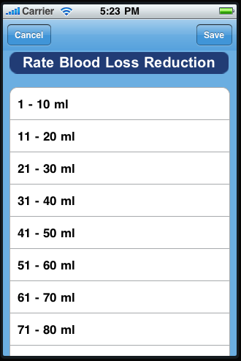
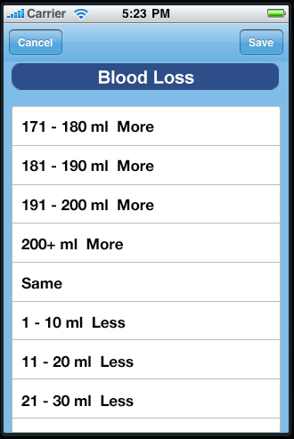
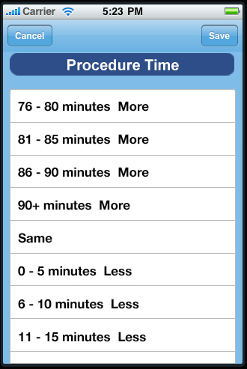
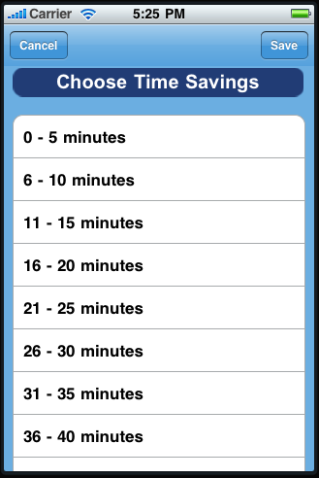
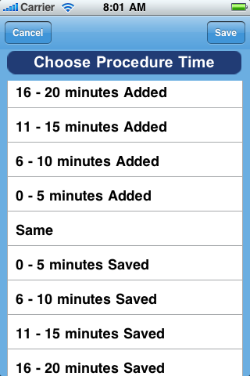
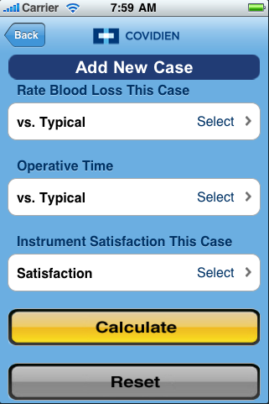
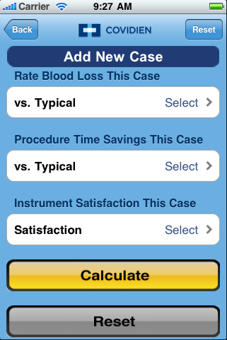
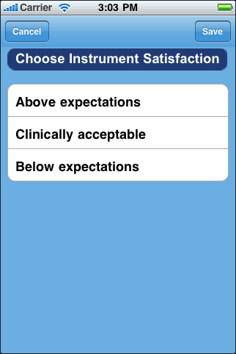
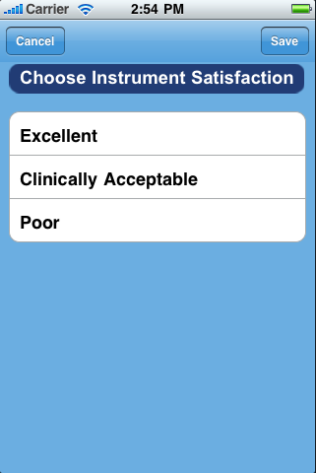
Blood Loss, Time & Satisfaction
OR time cost set at
$10/ minute per Sandburg study calculated at upper end of range
<number> |
COVIDIEN, COVIDIEN with logo and positive results for life are U.S. and/or internationally registered trademarks of Covidien AG. Other brands are trademarks of a Covidien company. © 2010 Covidien. All rights reserved. R0012720

Slide 10
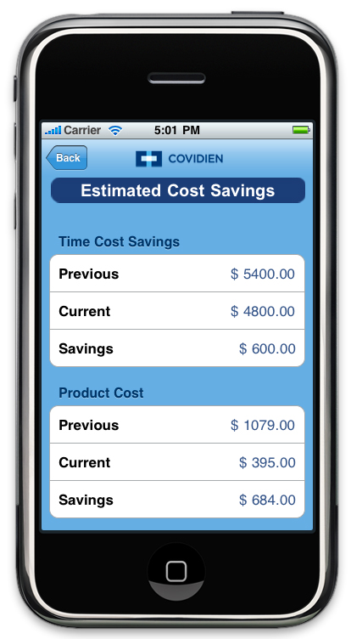
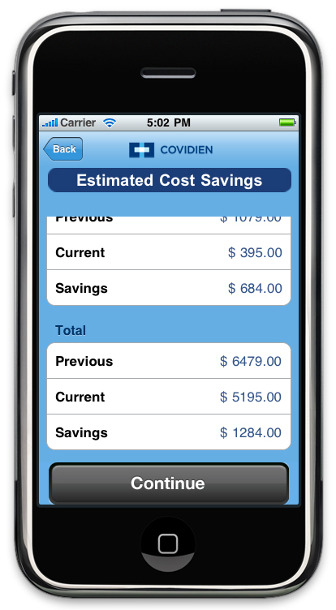
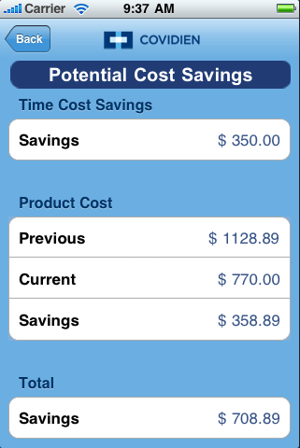
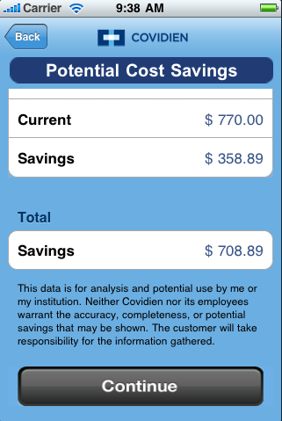
Summary Data
<number> |
COVIDIEN, COVIDIEN with logo and positive results for life are U.S. and/or internationally registered trademarks of Covidien AG. Other brands are trademarks of a Covidien company. © 2010 Covidien. All rights reserved. R0012720

Slide 11
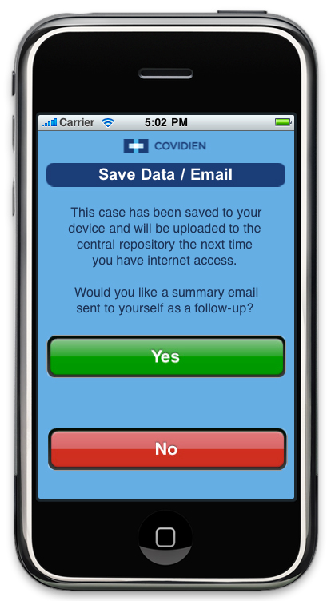
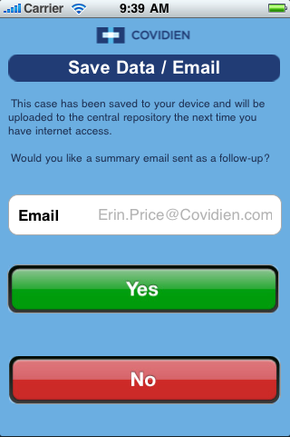
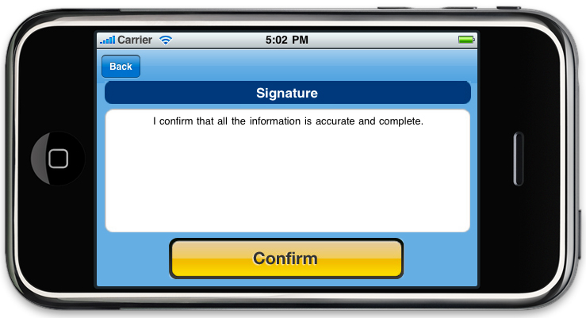
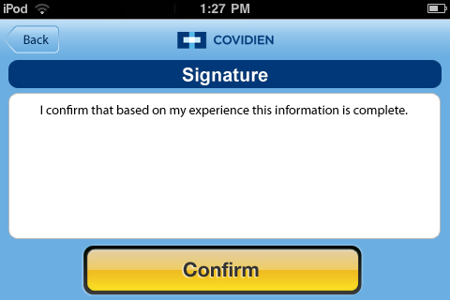
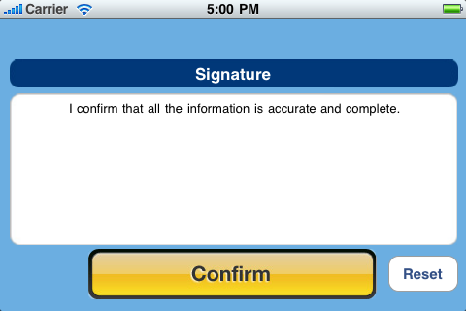
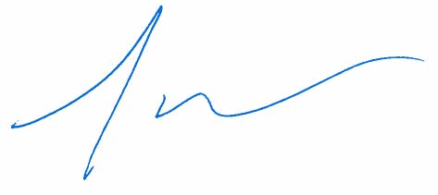
Sign and Save
<number> |
COVIDIEN, COVIDIEN with logo and positive results for life are U.S. and/or internationally registered trademarks of Covidien AG. Other brands are trademarks of a Covidien company. © 2010 Covidien. All rights reserved. R0012720

Slide 12
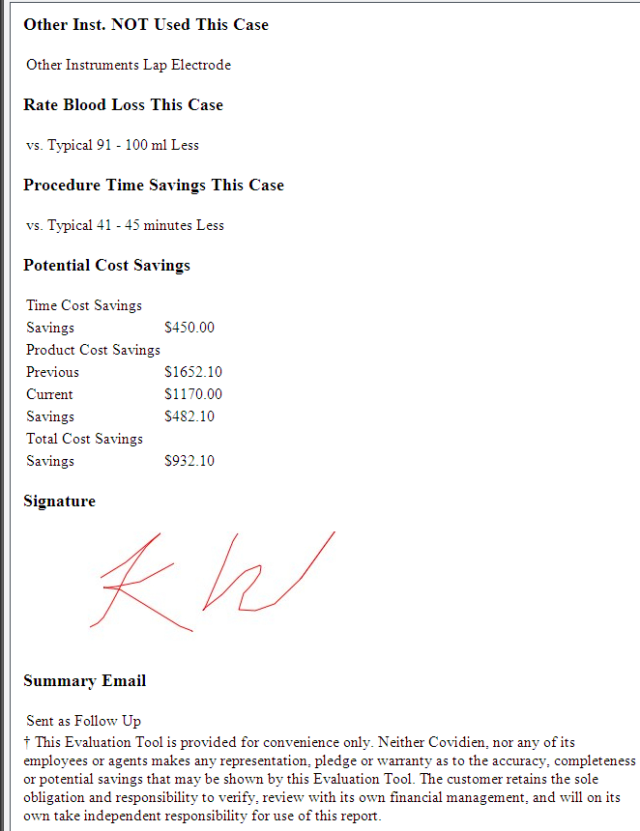
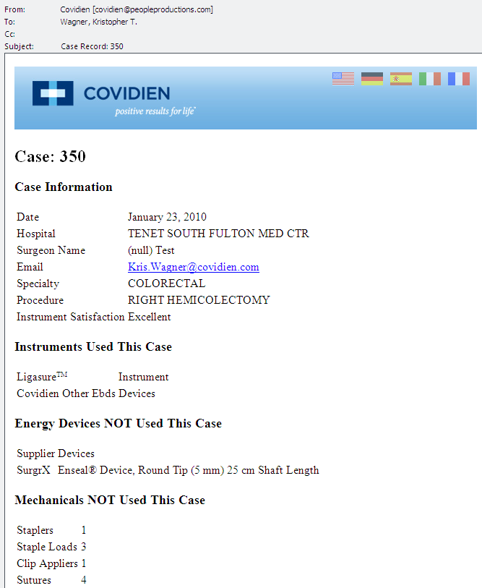
Case Summary Email
<number> |
COVIDIEN, COVIDIEN with logo and positive results for life are U.S. and/or internationally registered trademarks of Covidien AG. Other brands are trademarks of a Covidien company. © 2010 Covidien. All rights reserved. R0012720

